Slide 1
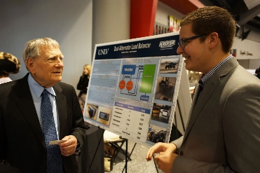

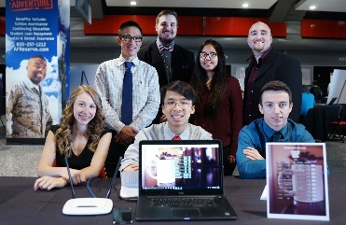
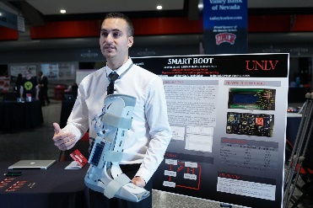
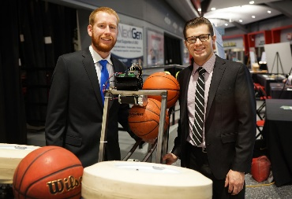
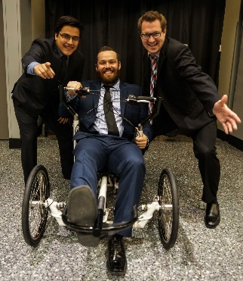
WELCOME TO YOUR SPRING 2026 SENIOR DESIGN!

Slide 2
SENIOR DESIGN COMPETITION
Spring 2026
Competition:
Tuesday, May 5, 2026 8am - 6pm
Location:
Engineering Complex

Slide 3
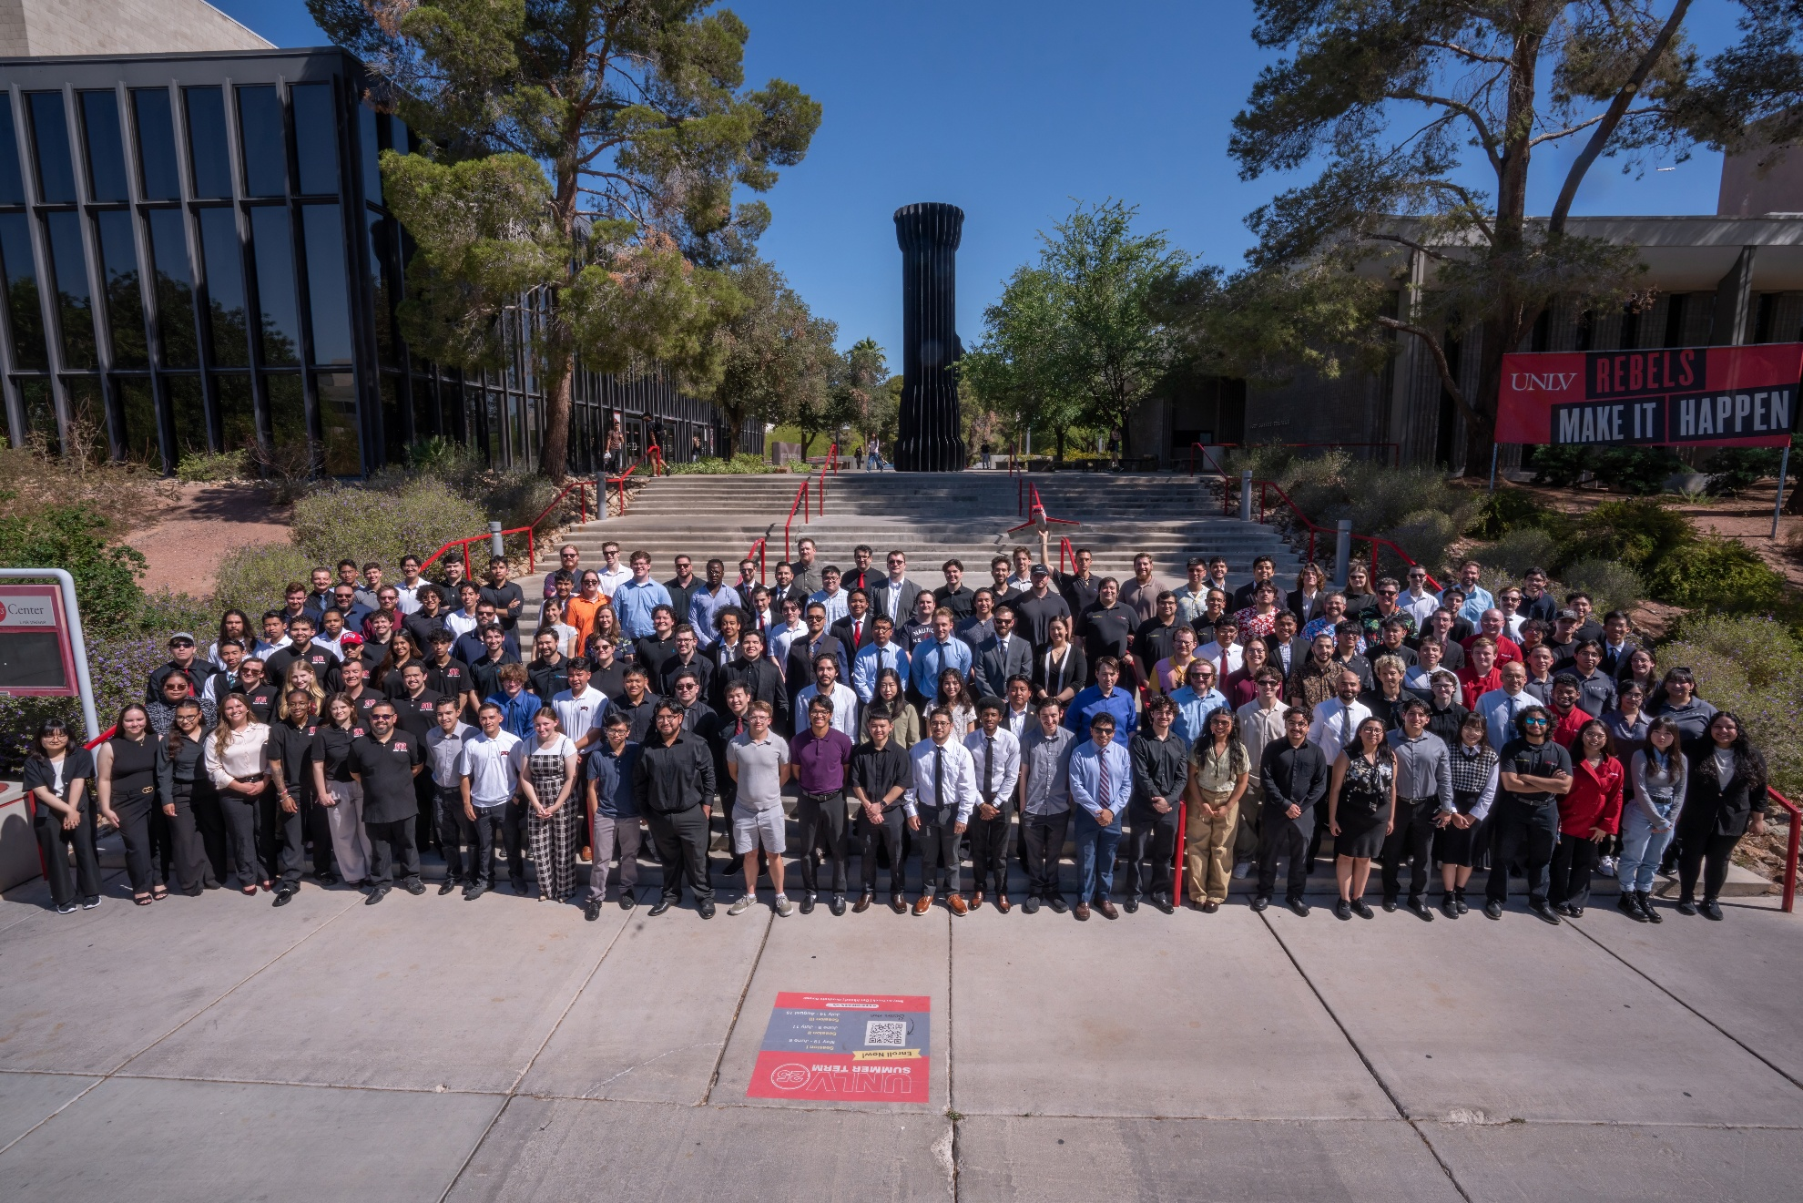
Class of Spring 2025 Senior Design

Slide 4
Professional Team Photos
Professional team photos will be taken at no charge on the dates and times below:
Monday, March 2nd : 12PM-4:30PM*
&
Tuesday, March 3rd : 8AM-1PM*
Professional attire for team photo.
*Time slots will be filled as received; these are the only 2 days we will take team photos.

Slide 5
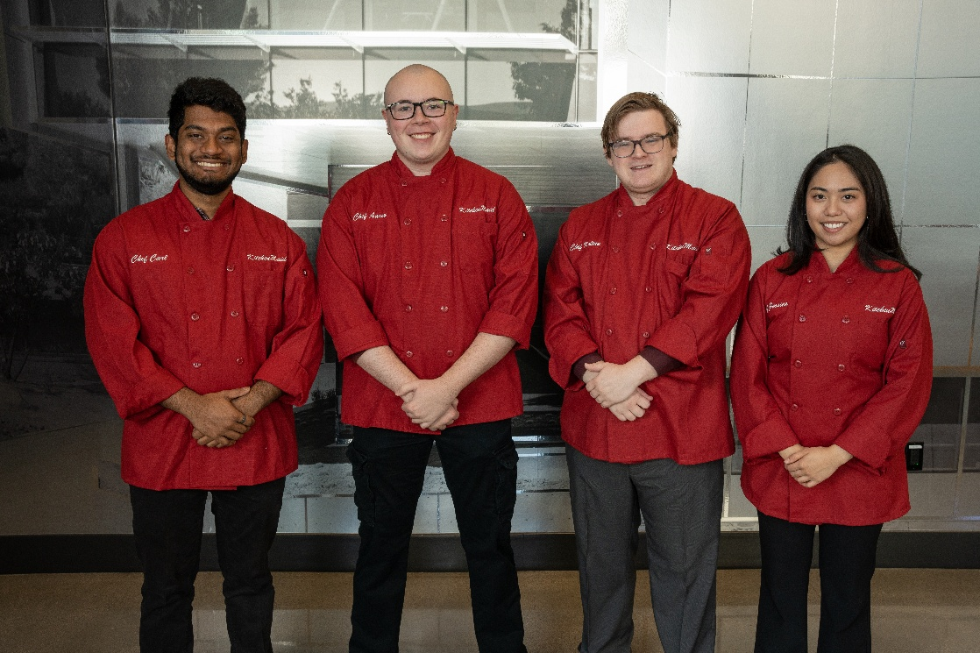
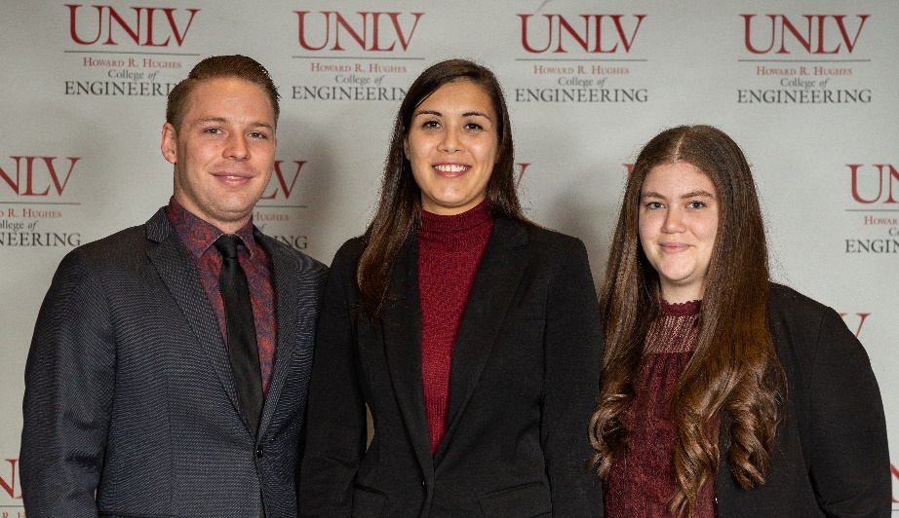
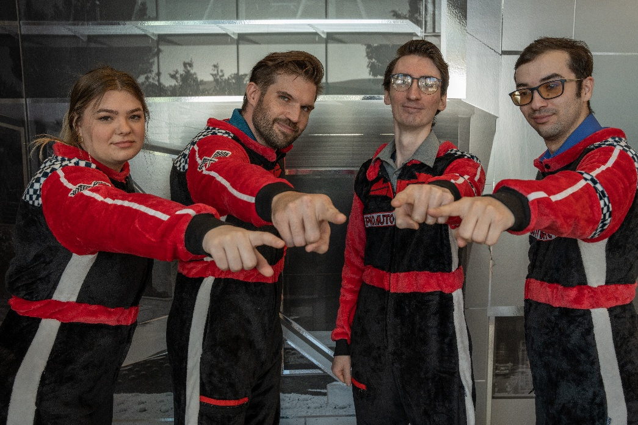
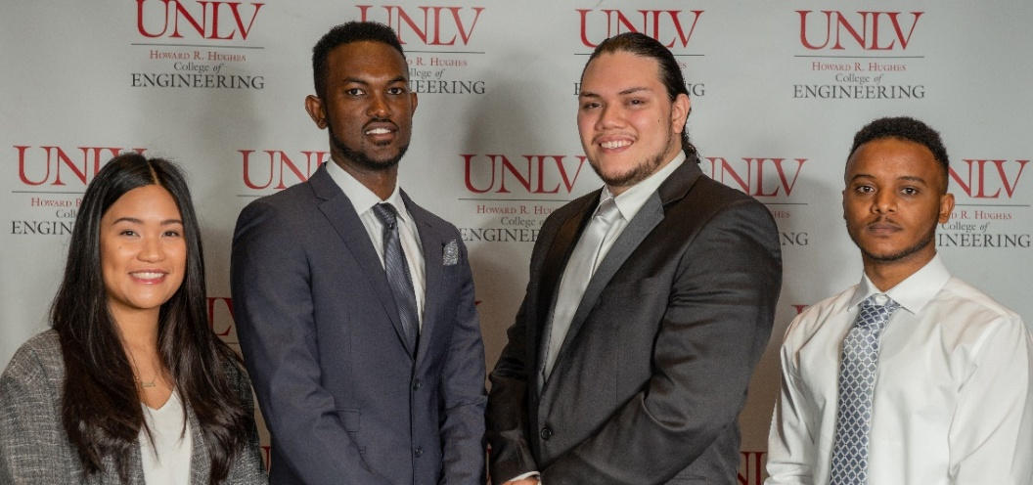

Slide 6
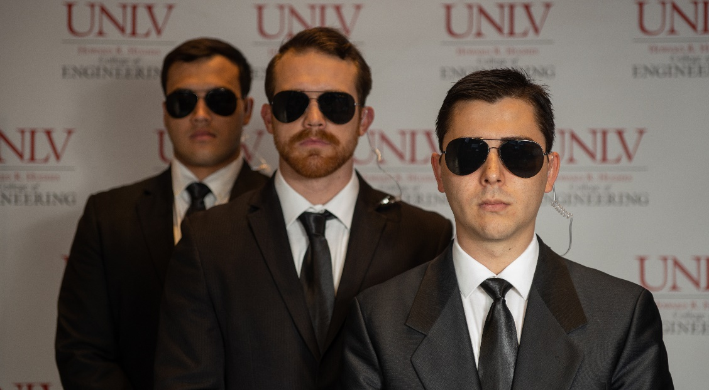
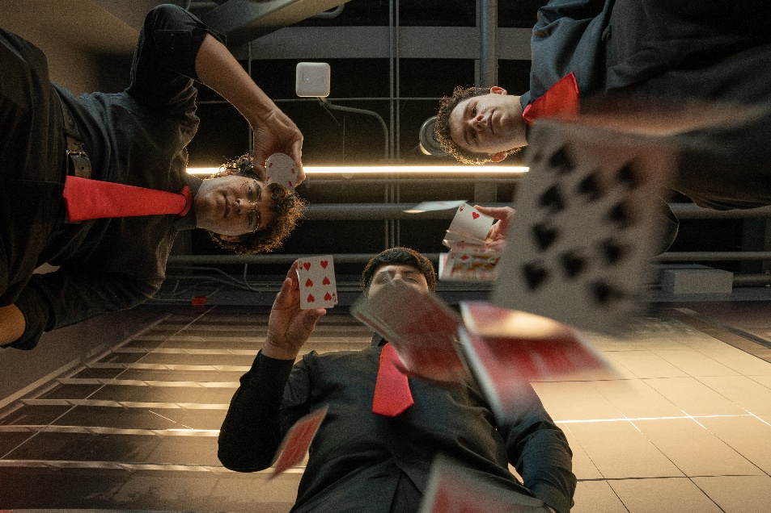
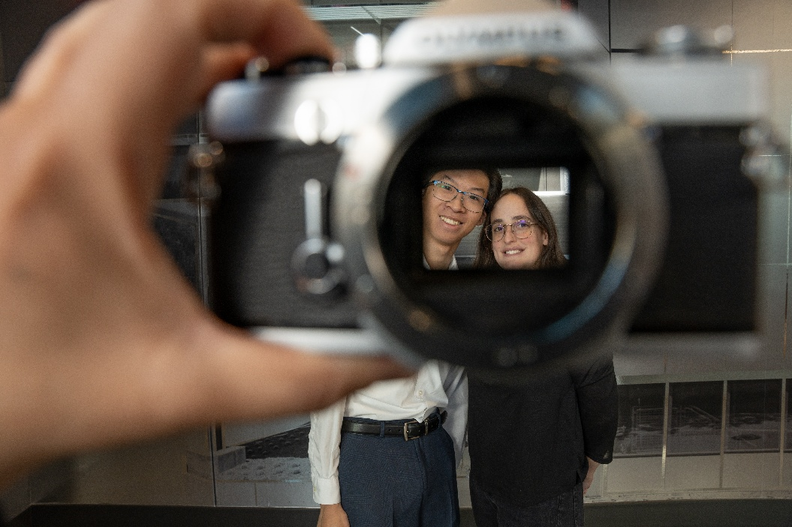
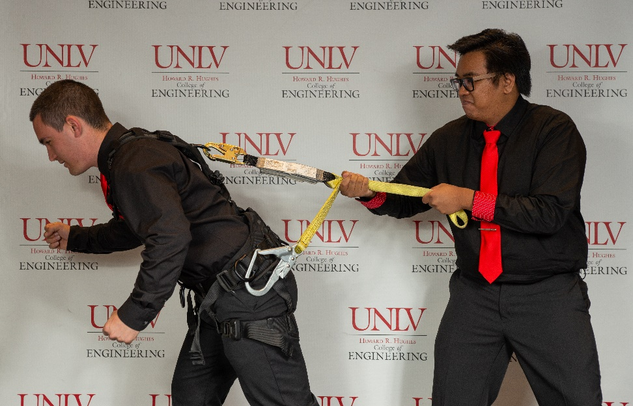

Slide 7
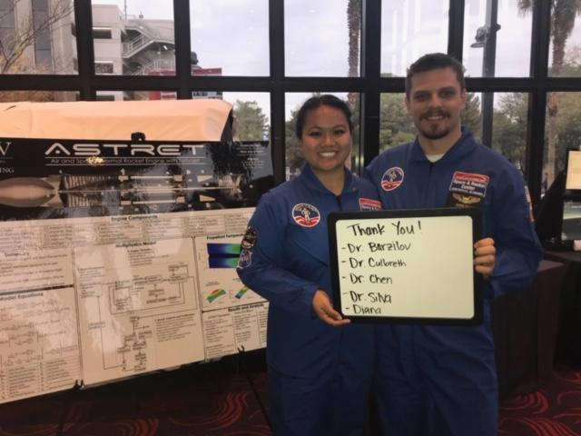
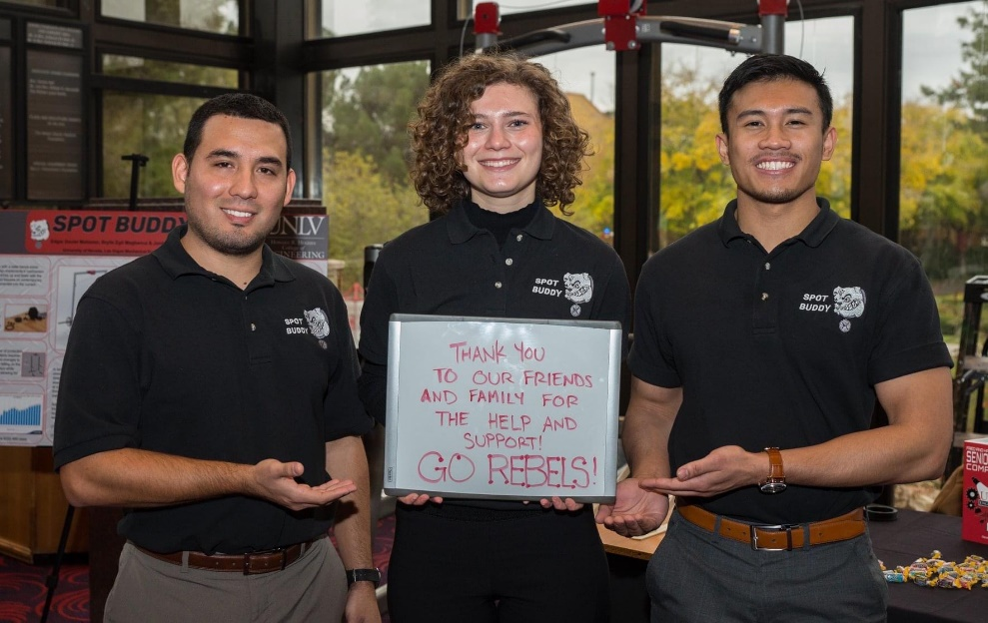
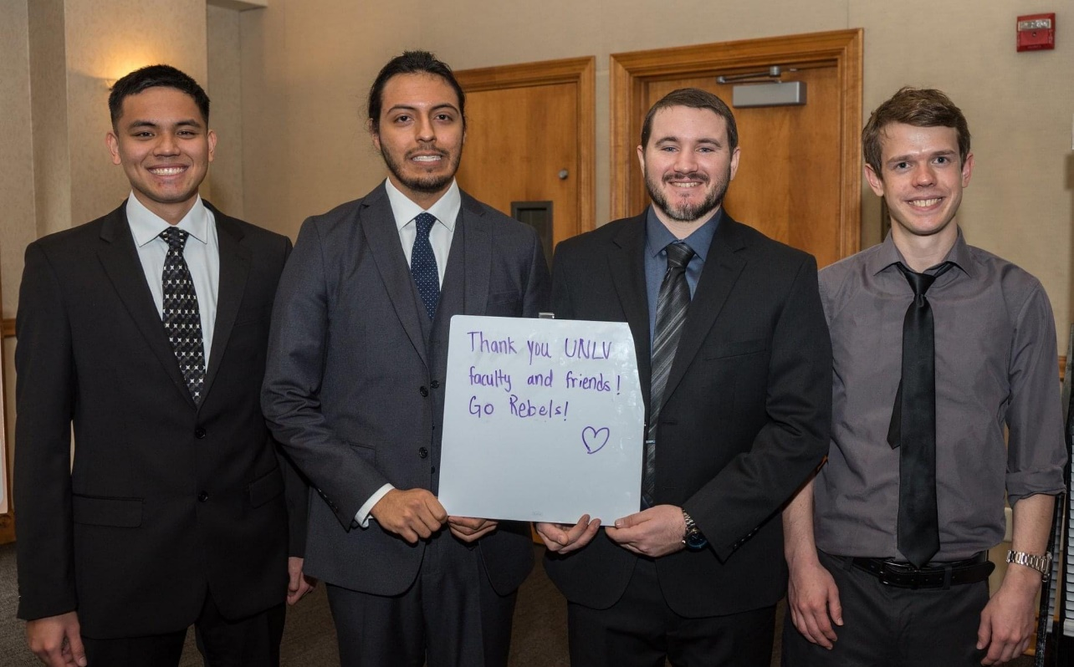
UNIFORMS
POLO SHIRTS
SUIT AND TIE

Slide 8
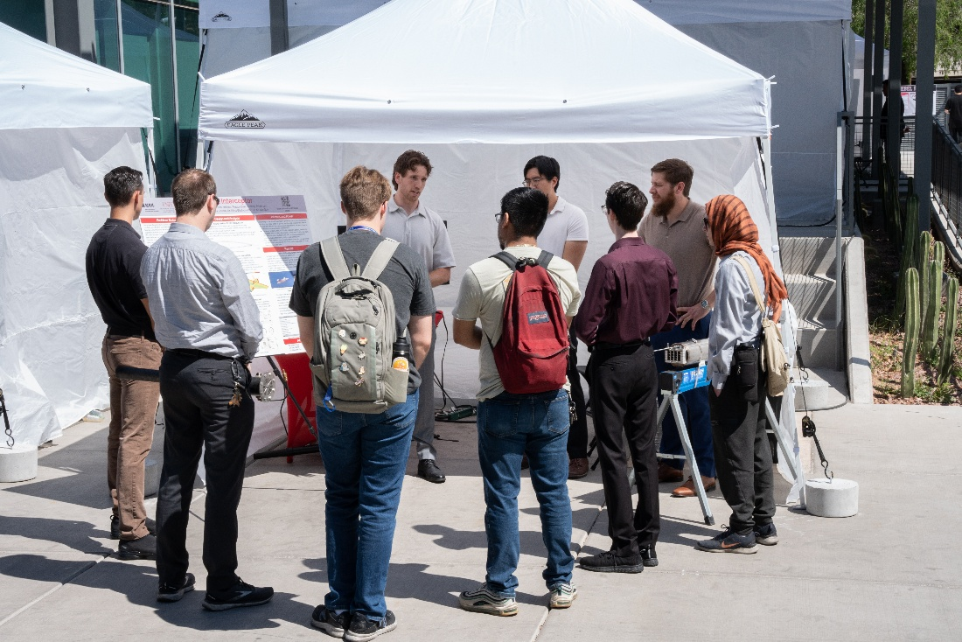
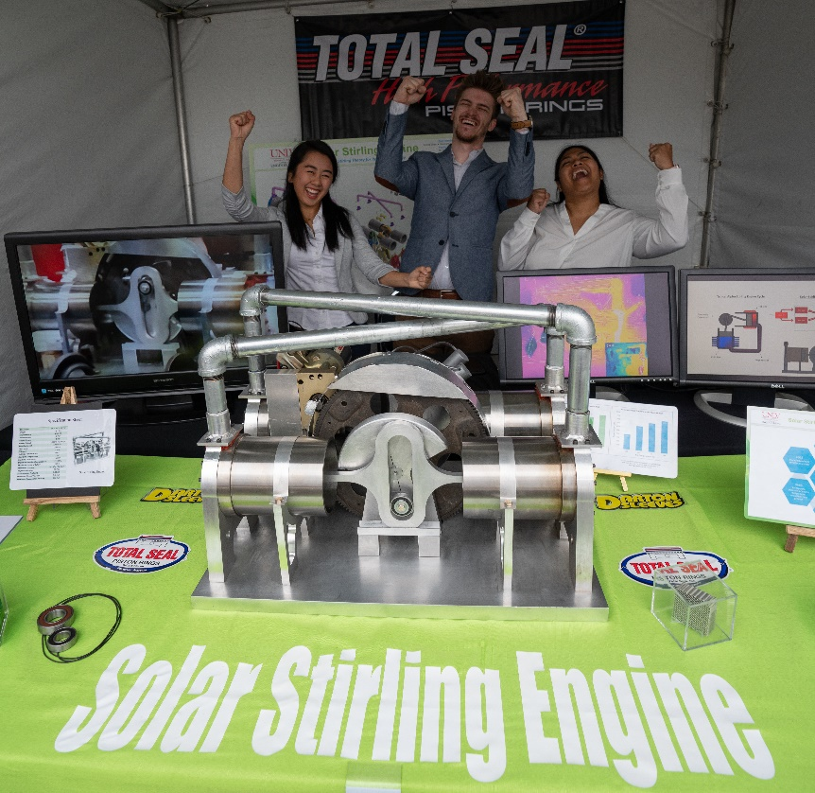
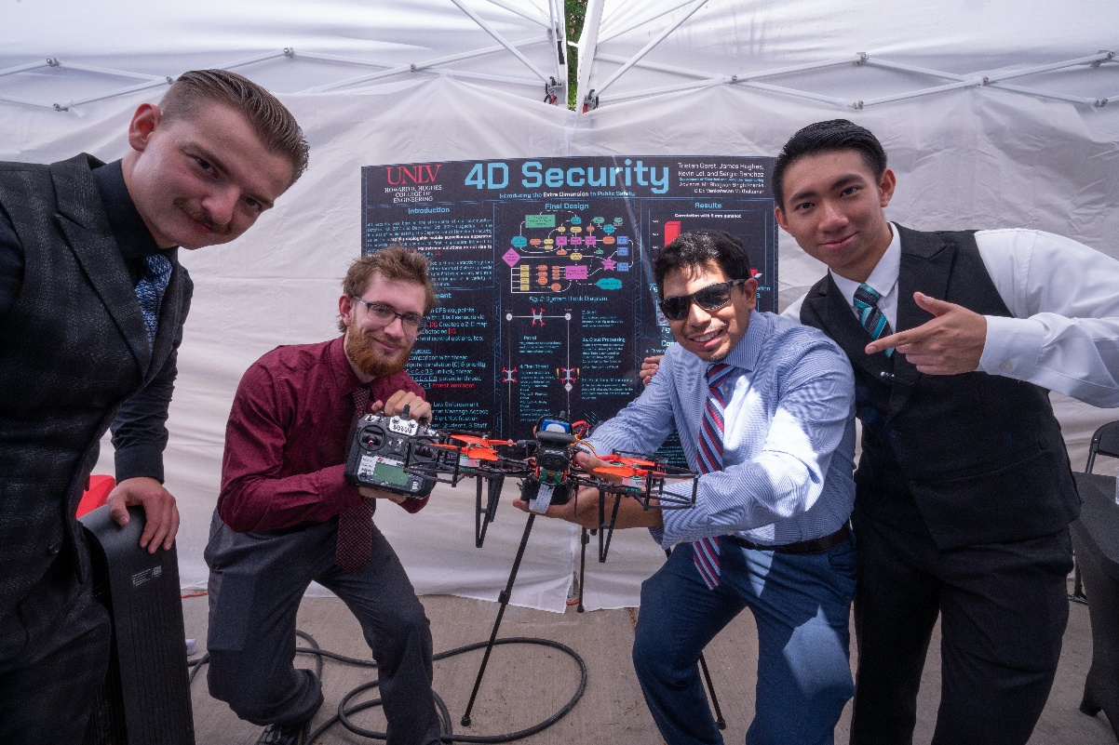

Slide 9
Poster file in pdf sized to 48x36 inches due to
Molly.marks@unlv.edu on or before 4.16.25!
Please utilize the poster template that was provided
to you as well as the YouTube video link and
PowerPoint slides from previous
poster workshops.

Slide 10
REIMBURSEMENTS
Maximum reimbursement from the college is $1000.00 per team.
Teams can seek supplemental funding from other sources
College can provide tax information if needed for these requests
Reimbursement documents are due to your department AA no later than 4:50pm on Tuesday, May 12th
Documents include: bank statements, credit card statements, receipts, reimbursement document, etc…
Please review all details on reimbursements located in the following slides as well as in the FAQ and Reimbursement Document provided.

Slide 11
NON-REIMBURSABLE ITEMS
Only teams that participate in the competition will be eligible for reimbursement.
Clothing (unless logo or themed for the project)
Computers/Laptops/Tablets
Smart Phones/Cell Phones
Printers
Consulting and/or Subcontracting Fees
Website Hosting, Building/Developing, Maintenance, Design, Etc.
Food and beverages
If your team feels that they need to purchase something from the above list please email Molly to see if an exception can be made.

Slide 12
SPECIAL NEEDS ITEMS
If your team does not request your special needs by the due date, March 4, 2026 then the special needs WILL NOT be met! It is your team's responsibility to submit your request for anything other than:
1 Table
1 Table Linen
1 Easel
2 Chairs
1 Tent with 3 walls

Slide 13
SPECIAL NEEDS ITEMS
You may request specially needed items from this list. We are unable to provide anything beyond the options available:
Electricity (Including number of outlets)
Extra Easels
Extra Space (restrictions due to location of event.)
Extra Tables
Extra Linen
Internet (Wireless)
* We do NOT supply: Carts to move items, televisions, monitors, computers, etc.

Slide 14
RESOURCES FROM THE COLLEGE
MAKER SPACE
3D printers: one FDM printer i.e. Stratasys F370CR, one Stratasys SLA printer i.e. the J5 Med-Jet, AND two Formlabs model 3BL SLA medical printers.
Three UNIVERAL brand later cutters (60w, 75w, 150w).
For use in these cutters, a selection of 1/8” cast acyclic will be available for purchase in the lab provided the Atrium/Rebel Cash system is operational
Metal working machines include:
48” pan brake
52” hydraulic press
variable speed drill press
manual lathe
CNC capable knee mill.

Slide 15
RESOURCES FROM THE COLLEGE
MAKER SPACE
Electronics test benches equipped with :
an oscilloscope, DMM, arbitrary wave generator, power supply, soldering station w/supplies, and an Opti-visor are on hand.
The lab has a selection of hand tools including:
Screw drivers, pliers, socket wrenches, combination wrenches, small plier set, file set, & chisel/punch set. An electric pedestal grinder, a pedestal vise, small project vices, hand drills, impact drivers, along with drill bits, driver bit sets, and work tables are available.
Additionally, there are six small computers w/Illustrator & Solidworks for 2 & 3D design respectively

Slide 16
RESOURCES FROM THE COLLEGE
MAKER SPACE
Hours: 8am-4:30pm, Monday through Friday.
3D printing and materials are free to College of Engineering students.
Costs for Laser Cutter materials are somewhere between $16-$24 per sheet.
General safety orientation is required to use the Maker Space.
Maker Space staff can remove individuals from working in the space if they feel they are being disruptive.

Slide 17
SCORING RUBRIC
Quality & Completeness Score: The quality of the prototype and or report (15 points possible)
Poster Presentation Score: How well is the poster laid out? Is it easy to follow along? Did the team explain the poster & use it as a supplemental piece to their presentation versus reading off of it? (7 points possible)
Technical Merit Score: Technical detail of the project/constraint/alternative design analysis, testing & quality of test data. (25 points possible)

Slide 18
SCORING RUBRIC… CONTINUED
Potential for Commercialization Score: Possibility to commercialize or implement project, potential for salability or other applications/spin-offs, economic analysis. (15 points possible)
Innovation Score: How innovative is the project/idea? Is this a new concept? Did the team develop the idea/project on their own or was it brought to them by a community partner? For this category you are looking for the teams that REALLY thought outside of the box. (15 points possible)

Slide 19
SCORING RUBRIC… CONTINUED
Sustainability Score: How well does the design meet human needs, have positive benefits or else minimalor no harmful effects to the environment, economy & society. (15 points possible)
Oral Presentation Score: How well organized was the team in their presentation? Please consider clarity, structure & team member participation. (10 points possible)

Slide 20
PRIZES
**CEEC, CS, ECE, EED & ME
1st - $300 per student team member
2nd - $150 per student team member
**Interdisciplinary
$350 per student team member
*Commercial Potential
$325 per student team member
* Can be won in addition to department awards ** If the category only has one team competing, then the team score must be equivalent to other department scores to receive a prize.

Slide 21
PRIZES
*Sustainability
$225 per student team member
*Popular Choice
$125 per student team member
*Team Congeniality
$100 per student team member
*Innovation
$200 per student team member
Grand Prize
$500 per student team member
* Can be won in addition to department awards

Slide 22
AWARDS NIGHT!
WHEN: Friday, May 8th , 6:30pm-9:30pm
WHERE: Thomas and Mack, The Pavilion
WHO: Senior Design students, guests, faculty, staff and donors
WHY: To recognize all that you have done throughout your College of
Engineering Journey
PLANNED AGENDA:
6:30PM – Doors open to The Pavilion for dinner
7:15PM- Awards begins
9:00PM – Awards conclude

Slide 23
DINNER DETAILS
STUDENTS AND 1 GUEST ARE FREE TO ATTEND
ADDITIONAL GUESTS ARE $75
DEADLINE TO RSVP FOR AWARDS RECEPTION IS
April 28, 2026
TO RSVP YOU MUST COMPLETE THE RSVP FORM, EVEN IF YOU ARE NOT BRINGING ADDITIONAL GUESTS

Slide 24
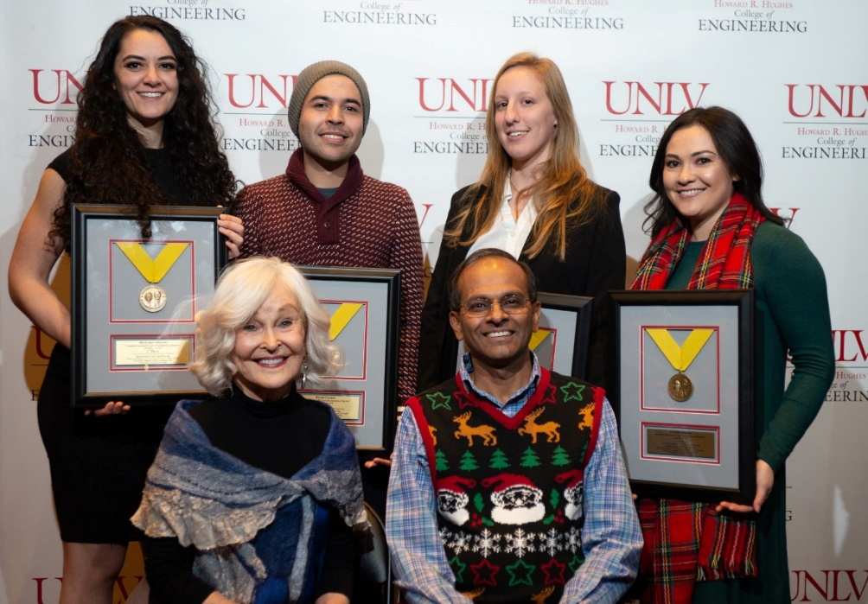
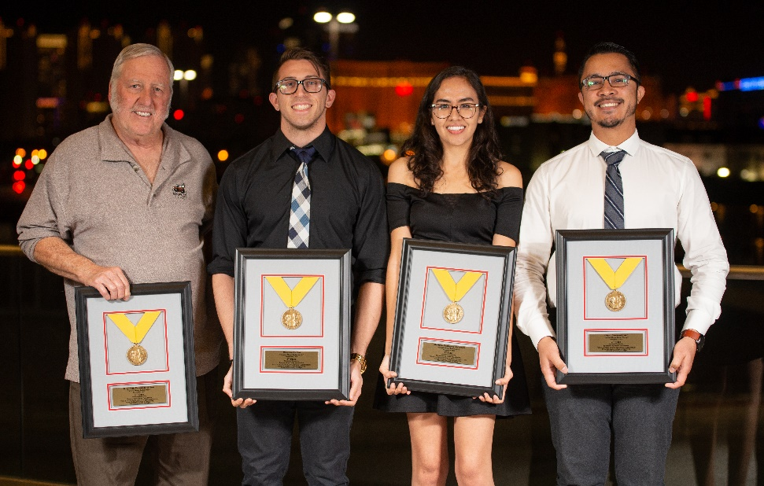
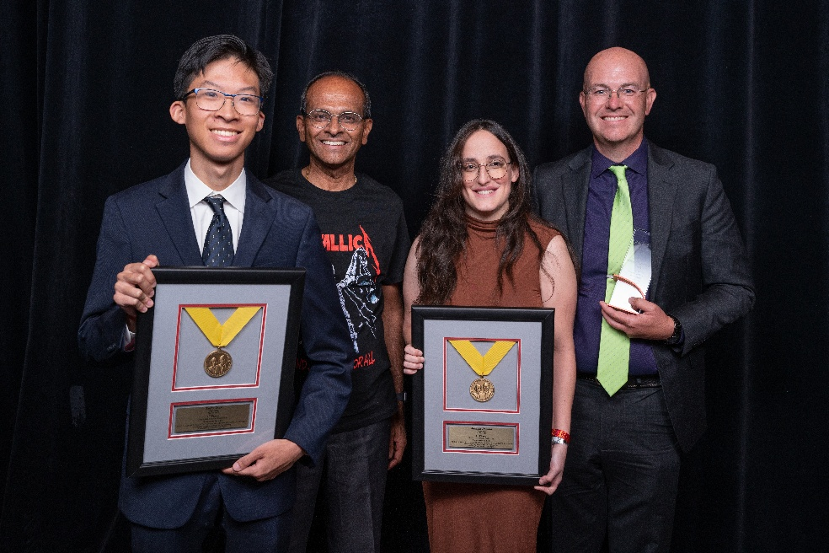
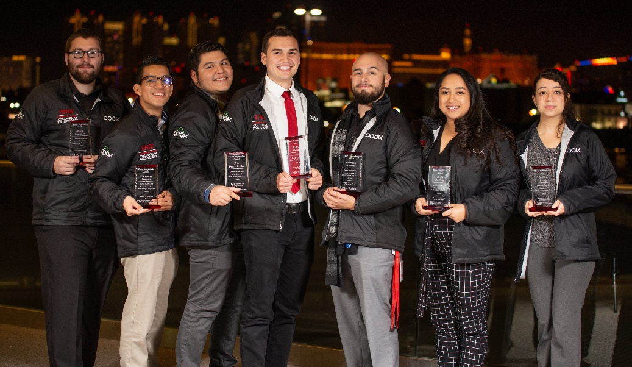

Slide 25
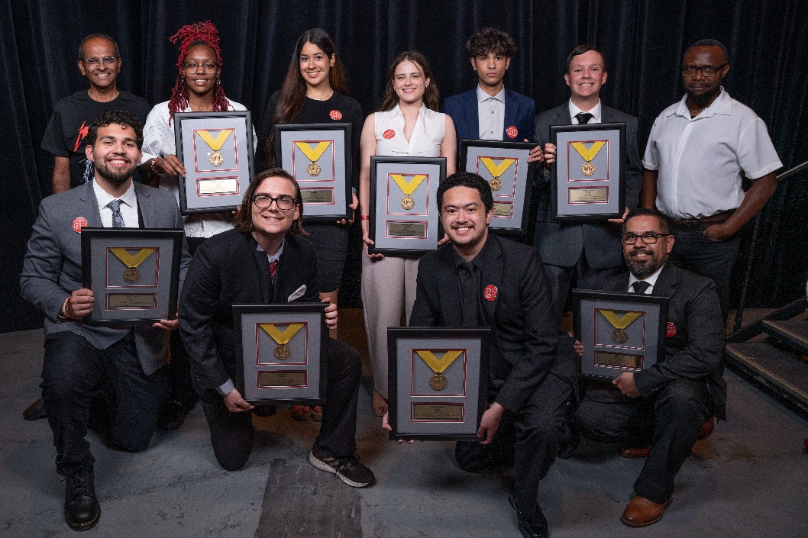
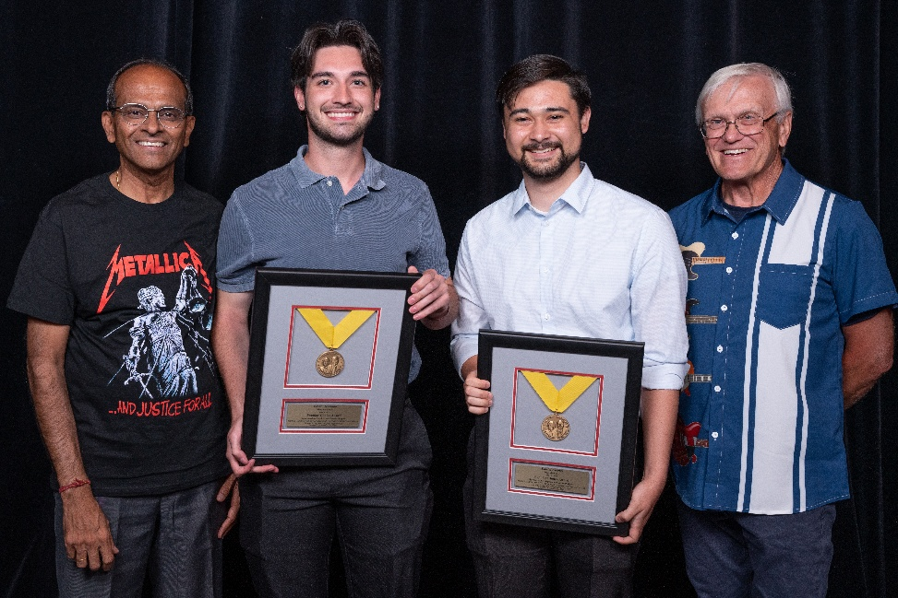
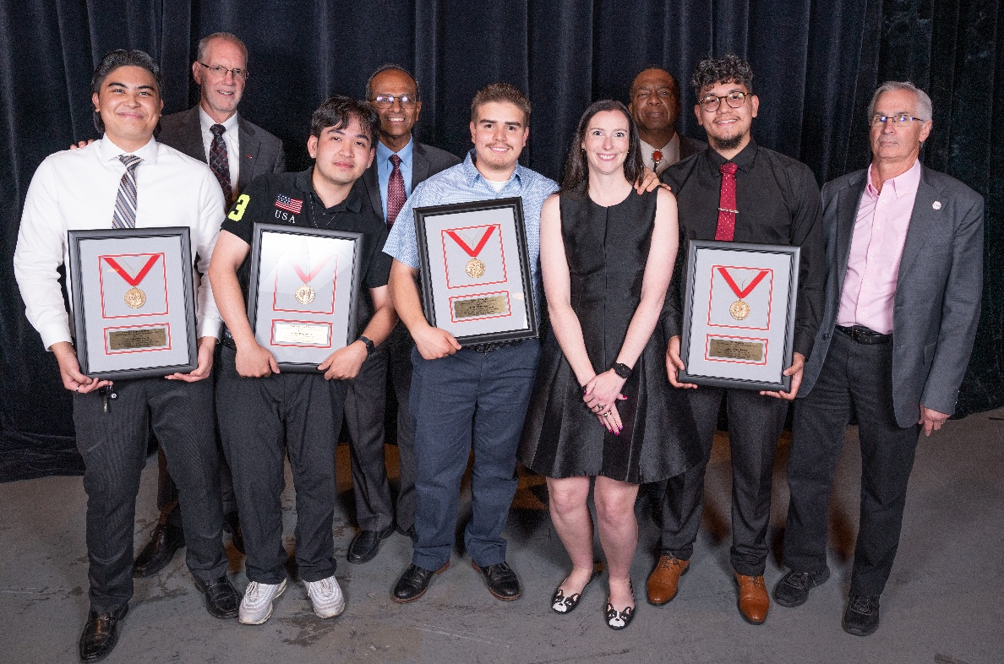

Slide 26
IMPORTANT DATES/DEADLINES
1/30/26: Data contact sheet due
2/12/26: Last day to email Molly to schedule a Team Photo
2/24/26: Project Abstracts– Email to Molly at molly.marks@unlv.edu as a WORD doc
3/2/26: Professional Photos Day 1: 12PM-4:30PM
3/2/26: Final day to drop from the competition!
3.3.26: Professional Photos Day 2: 8AM-1PM
3/4/26: Last day to submit special needs request
3/24/26: Presentation times emailed to students

Slide 27
IMPORTANT DATES/DEADLINES
4.16.26: Poster PDF file due to Molly at molly.marks@unlv.edu
4/28/26: RSVP deadline for awards (link will be provided) student and one guest is free ($75 for additional guests) – MUST RSVP at link if attending
5/4/26: Set up, Engineering Complex, 10am-4pm
5/5/26: Competition, 8am-5pm, Engineering Complex
5/12/26: Reimbursement items (receipts & completed reimbursement document)
due to your department Administrative Assistant by 4:30pm- NO EXCEPTIONS
CEEC- Chandana.jamjam@unlv.edu
CS- Mario.martin@unlv.edu
ECE- Cameron.Williams@unlv.edu
ME- Chandashree.goddudharmegowda@unlv.edu
EED- Rachel.Soriano@unlv.edu
5/8/26: Awards Dinner, 6:30pm-9:30pm, The Pavilion
**Teams will only be reimbursed if they participated in the competition**
Teams MUST be present at awards or any monetary
award will be forfeited.

